Slide 1
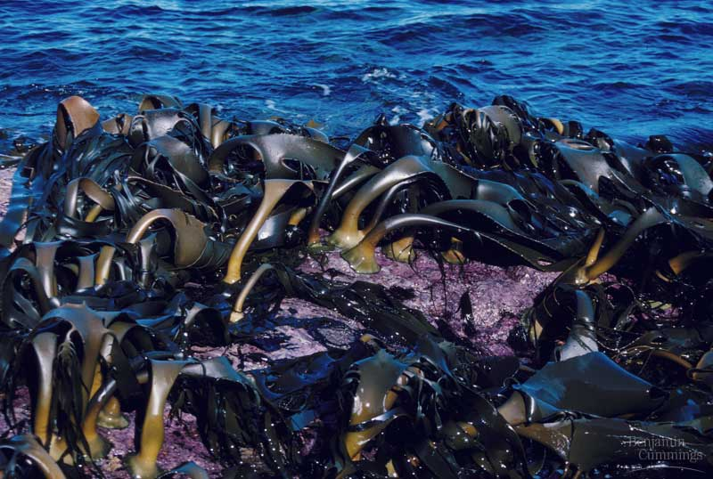
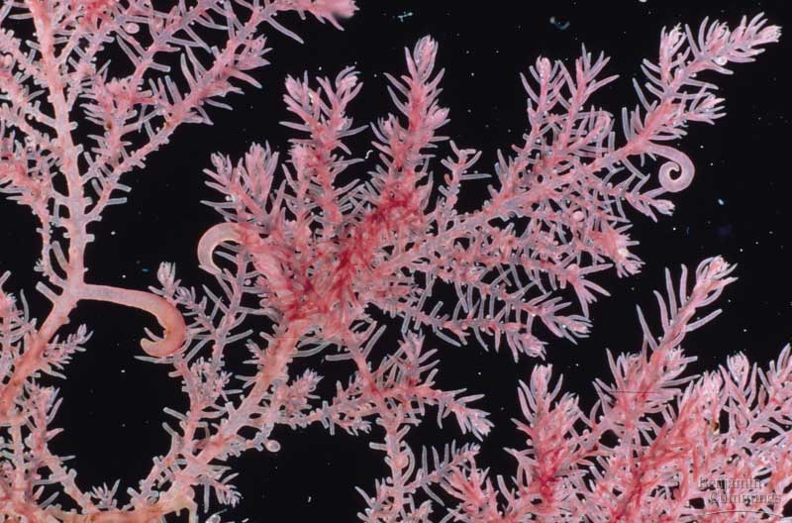
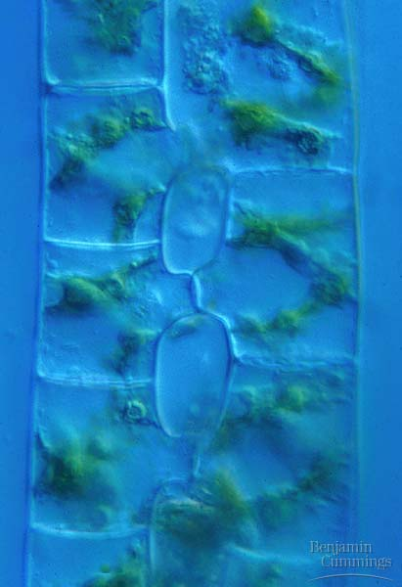
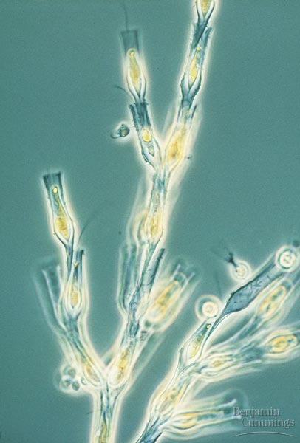
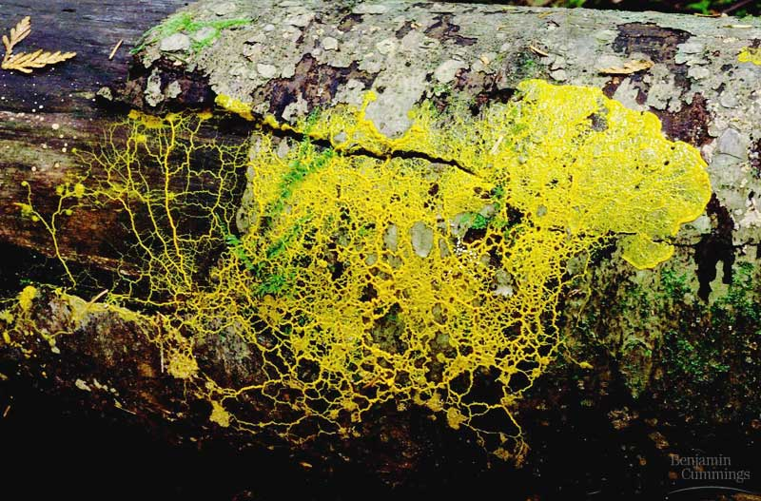
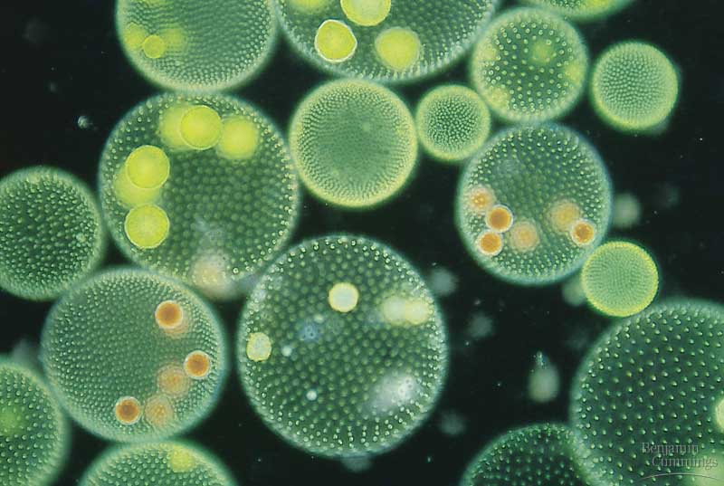
Algae
An Overview

Slide 2
General Characteristics
Range in size from microscopic to single celled organisms to large seaweed
Autotrophic
Form the reproductive structures – gametangia or gamete chambers (cryptogams)
Aquatic and have flagella at some point in life
Often contain pyrenoids, organelles that synthesis and store starch

Slide 3
STRUCTURE
Thallus (haploid)
Four types of algae
Unicellular
Colonial
Filamentous
multicellular

Slide 4
IDENTIFY THE TYPE OF ALGAE

Slide 5
CLASSIFICATION OF ALGAE
Four PHYLUM BASED ON (by G M Smith)
COLOR
TYPE OF CHLOROPHYLL
FOOD-STORAGE SUBSTANCE
CELL WALL COMPOSITION
Cyanophyta
Chlorophyta
Xenthophyta
Rhodophyta

Slide 6
REPRODUCTION
MOST REPRODUCE BOTH SEXUALLY AND ASEXUALLY
Most sexual reproduction is triggered by environmental stress
Asexual Reproduction
Mitosis (aplanospore)
Sexual Reproduction
Meiosis
Zoospores
Plus and minus gametes
Zygospore

Slide 7
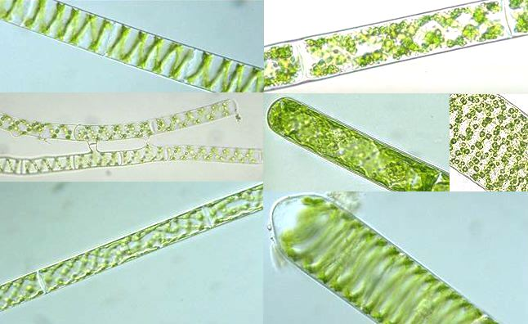
Spirogyra

Slide 8
Classification(Systematic Position)
Class: Chlorophyceae
Order: Conjugales (zygnematales)
Family: Zygnemataceae
Genus: Spirogyra

Slide 9
Occurrence
Very common, free floating, fresh water algae.
Found in fresh water pools, lakes, ditches etc.
Some time in streams and running water.
The filaments are slimy, because of mucilaginous substance around it,
It is also call as “pond silk”, “water silk”
Filament forms floating mass on the water surface

Slide 10
Spirogyra is very common in relatively clean eutrophic water, developing slimy filamentous green masses.
In spring Spirogyra grows under water, but when there is enough sunlight and warmth they produce large amounts of oxygen, adhering as bubbles between the tangled filaments.
The filamentous masses come to the surface and become visible as slimy green mats.
There are more than 400 species of Spirogyra in the world.

Slide 12
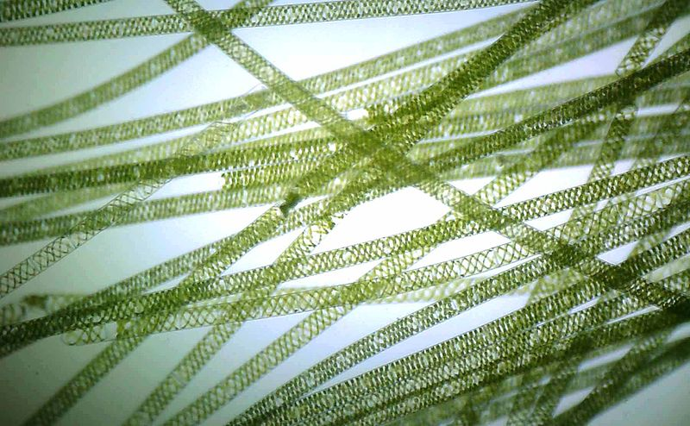
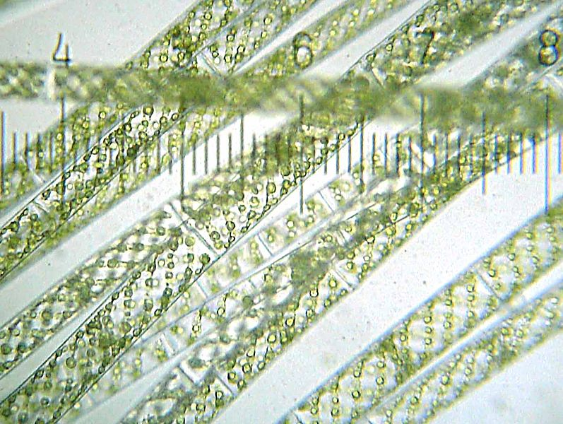

Slide 13
External Features
Filaments are un-branched, multi-cellular, slippery to touch,
No distinction in apex cell or base cell, all cell are alike throughout the filaments,
cylindrical cell, arranged cell to cell.

Slide 14
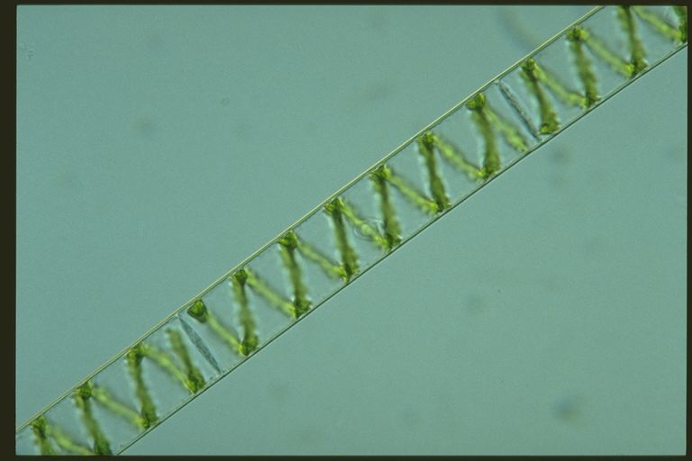

Slide 15
Cell Structure
The cell wall has two layers: the outer wall is composed of pectin that dissolves in water to make the filament slimy to touch while the inner wall is of cellulose.
The cytoplasm forms a thin lining between the cell wall and the large vacuole it surrounds, sometimes it is also called 3rd wall.
Chloroplasts are embedded in the peripheral cytoplasm; their numbers are variable (as few as one sometime up to 14).

Slide 16
Cell Structure (cont....)
The chloroplasts are ribbon shaped and spirally arranged with wavey surface, resulting in the prominent and characteristic green spiral on each filament.
Each chloroplast contains several pyrenoids, centers for the production of starches, appearing as small round bodies, which are responsible for the production of starch.
Each cell has a prominent nucleus in the center, suspended by thin strands of cytoplasm from the inner part of the cell wall.
The cells are long and thin, and each spirogyra filament measures between 10 to 100 micrometer in width. Sometimes, these filaments have root-like structures, which help them attach themselves to the substratum.

Slide 17
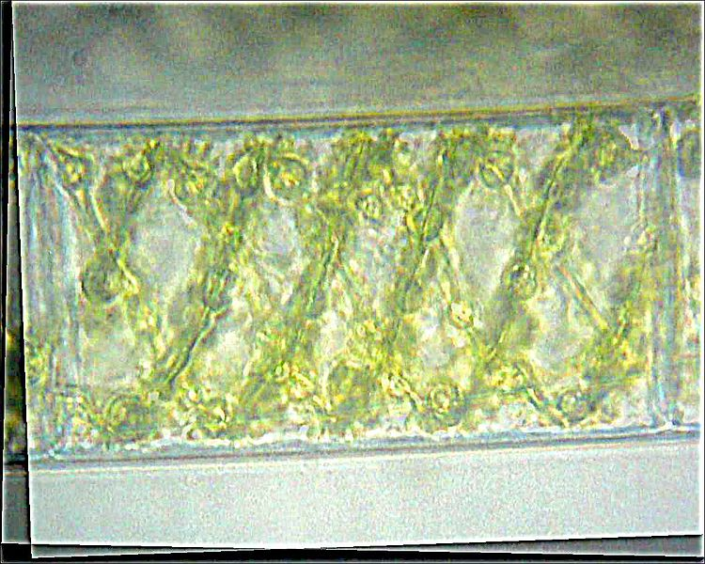

Slide 18
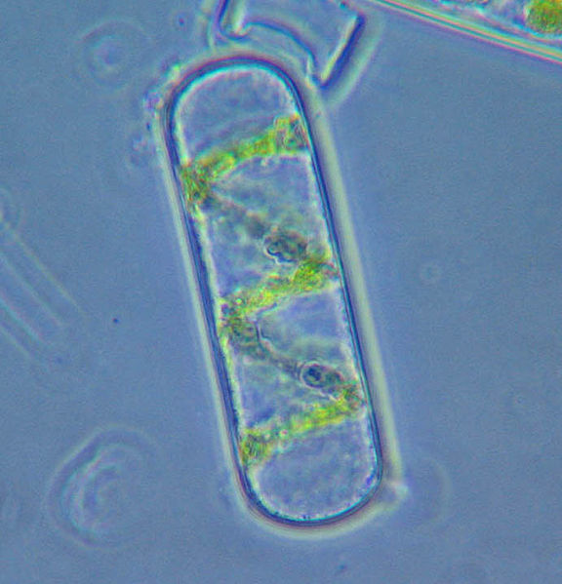

Slide 19
Reproduction
Spirogyra can reproduce both asexually and sexually.
(1) Asexual reproduction
Two types: (a) Vegetative and (b) by Aplanospore

Slide 20
(1) Asexual reproduction
(a) Vegetative reproduction
In vegetative reproduction, fragmentation takes place, and Spirogyra simply undergoes intercalary mitosis to form new filaments.
Sometime accidently or by feeding animal the filaments may breaks and forms many fragments, which forms new filaments.

Slide 21
(1) Asexual reproduction
(b) by spore
It takes place by menas of akinetes, aplanospores and azygospores.
These are formed due to the contraction of protoplasm and formation of new cellulose walls around it.
These spores are formed under unfavorable conditions, when water may dry from pond, the cytoplasm of the cell forms a spore like structure, which is call as aplanospore.
During favorable conditions, they germinate to form the new filament.
The aplanospore formation is very rare in the spirogyra.

Slide 22
2. Sexual reproduction
Sexual Reproduction is mean by conjugation no male or female filaments observed but call as positive and negative filaments.
two types of species observed
Heterothellic (+ve and –ve strands (gametes) are in different filament)
Homothellic (+ve and –ve strands (gametes) are in same filament)
Both reproductive structures are structurally similar so it is call as isogamets, but genetically different.
The cell which forms gametes is call as gametengia.
The Male gametes are amoeboid mobile, while female gametes are stable.

Slide 23
Sexual reproduction in Spirogyra takes place by conjugation.
Fusion of these non-flagllate gametes is resulted in zygospore.
Two methods of conjugation have been found in Spirogyra i.e.
Conjugation (sexual reproduction) is made by two types
(A) Scalariform (ladder)conjugation
(B) Lateral (chain) conjugation

Slide 24
(A) Scalariform conjugation
Scalariform conjugation requires association of two different filaments lined side by side either partially or throughout their length, therefore, the speceies are heterothallic.
In this case, two physiologically different filaments lie parallel to each other.
Then two outgrowths arise which are called conjugation tube. Further growth of the conjugation tube pushes the filaments apart.

Slide 25
Later the conjugation tube dissolves forming a passage. Simultaneously the protoplasm of the conjugated cells contracts and forms gametes.
The male gamete moves through the conjugation tube into the female cell of another filament.
Fusion of two nuclei results in formation of diploid zygospore.
After the formation of zygospore the cell of male filament becomes empty while the cells of the female filament are filled with zygospore.

Slide 26
Zygospore –
The mature zygospore has three layered walls. These zygospores are liberated by the death and decay of the female cell wall.
Zygospore germinates during favourable condition. Each zygospore nucleus divides meiotically to produce four haploid of which three degenerate and only one remains functional.
On germination, the zygospore gives rise to a single haploid filament. In this way, the life cycle is completed.

Slide 27
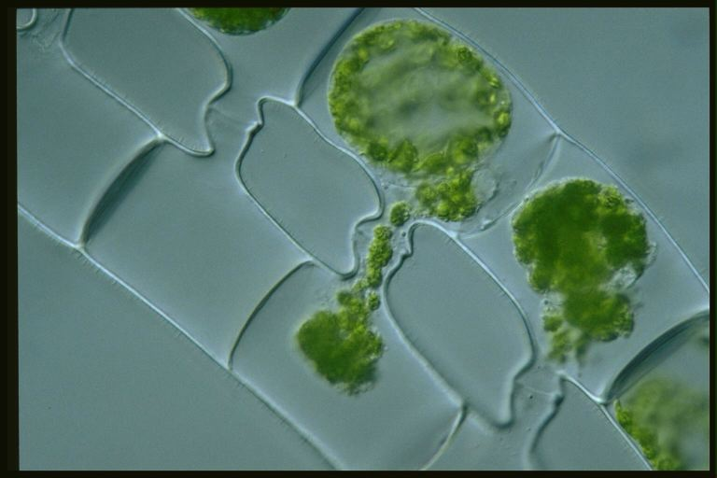

Slide 28
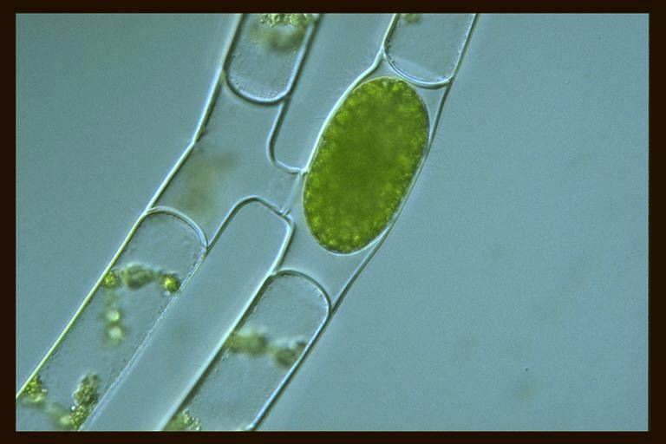

Slide 29
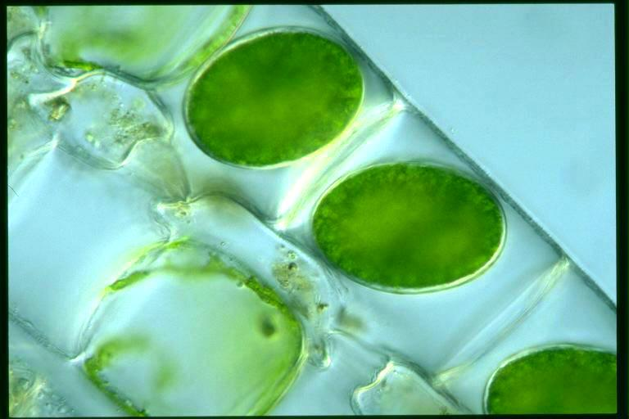

Slide 30
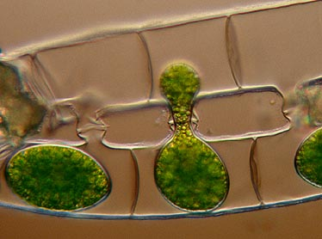
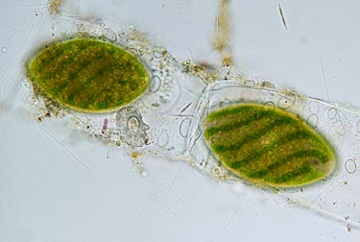

Slide 32
(B) Lateral conjugation
In lateral conjugation, gametes are formed in a single filament.
Two adjoining cells near the common transverse wall give out protuberances known as conjugation tubes, which further form the conjugation canal upon contact.
The male cytoplasm migrates through the conjugation canal, fusing with the female.
The rest of the process proceeds as in scalariform conjugation.

Slide 33
Lateral conjugation:
It takes place between two cells of the same filament. Such species are, therefore, called homothallic. Lateral conjugation again is of three types:
(a) Indirect (b) Terminal (c) Direct
(a) Indirect Lateral conjugation:
In this process there is a tube-like outgrowth in-between two adjacent cells close to the common cross walls. These outgrowths extend laterally ultimately forming conjugation tube. The contracted protoplasm of one cell moves to the adjacent cell and fuses to form the zygospore. The zygospore is diploid in nature.
(b) Terminal conjugation:
In this method, the so-called male gamete enters the female gamete by perforating the septum of conjugation tube. The conjugation tubes are produced on either side of the septum of the two conjugating cells.
(c) Direct Lateral conjugation:
In this case, the filament is attached to the substratum by its basal cell. Lateral conjugation takes place between two cells placed immediately next to the basal cell. One cell swells known as the female cell and the other cell becomes conical known as male cell. The male gamete passes through the septum piercing it. The nuclei are fused forming the diploid zygospore.

Slide 34
The essential difference is that scalariform conjugation occurs between two filaments and lateral conjugation occurs between two adjacent cells on the same filament.

